Slide 1
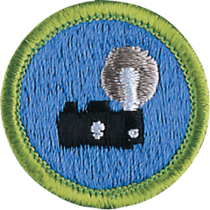
Photography
Merit Badge
Troop 344 & 9344, Pemberville, OH

Slide 2
Photography Merit Badge Requirements
Safety. Do the following:
  Explain to your counselor the most likely hazards you may encounter while working with photography and what you should do to anticipate, mitigate, prevent, and respond to these hazards. Explain how you would prepare for exposure to environmental situations such as weather, sun, and water.
  View the Personal Safety Awareness "Digital Safety" video (with your parent or guardian's permission).

Slide 3
Photography Merit Badge Requirements
Explain how the following elements and terms can affect the quality of a picture:
  Light—natural light (ambient/existing), low light (such as at night), and artificial light (such as from a flash)
  Exposure—aperture (f-stops), shutter speed, ISO
  Depth of field
  Composition—rule of thirds, leading lines, framing, depth
  Angle of view
  Stop action and blur motion
  Timing

Slide 4
Photography Merit Badge Requirements
Explain the basic parts and operation of a camera. Explain how an exposure is made when you take a picture.
Do TWO of the following, then share your work with your counselor.
  Photograph one subject from two different angles or perspectives.
  Photograph one subject from two different light sources—artificial and natural.
  Photograph one subject with two different depth of fields.
  Photograph one subject with two different compositional techniques.

Slide 5
Photography Merit Badge Requirements
Photograph THREE of the following, then share your work your counselor.
  Close-up of a person
  Two to three people interacting
  Action shot
  Animal shot
  Nature shot
  Picture of a person—candid, posed, or camera aware
Describe how software allows you to enhance your photograph after it is taken. Select a photo you have taken, then do ONE of the following, and share what you have done with your counselor.
  Crop your photograph.
  Adjust the exposure or make a color correction.
  Show another way you could improve your picture for impact.

Slide 6
Photography Merit Badge Requirements
Using images other than those created for requirements 4, 5 or 6, produce a visual story to document an event to photograph OR choose a topic that interests you to photograph. Do the following:
  Plan the images you need to photograph for your photo story.
  Share your plan with your counselor, and get your counselor's input and approval before you proceed.
  Select eight to 12 images that best tell your story. Arrange your images in order and mount the prints on a poster board, OR create an electronic presentation. Share your visual story with your counselor.
Identify three career opportunities in photography. Pick one and explain to your counselor how to prepare for such a career. Discuss what education and training are required, and why this profession might interest you.

Slide 7
Requirement 1
Safety. Do the following:
  Explain to your counselor the most likely hazards you may encounter while working with photography and what you should do to anticipate, mitigate, prevent, and respond to these hazards. Explain how you would prepare for exposure to environmental situations such as weather, sun, and water.
  View the Personal Safety Awareness "Digital Safety" video (with your parent or guardian's permission).

Slide 8
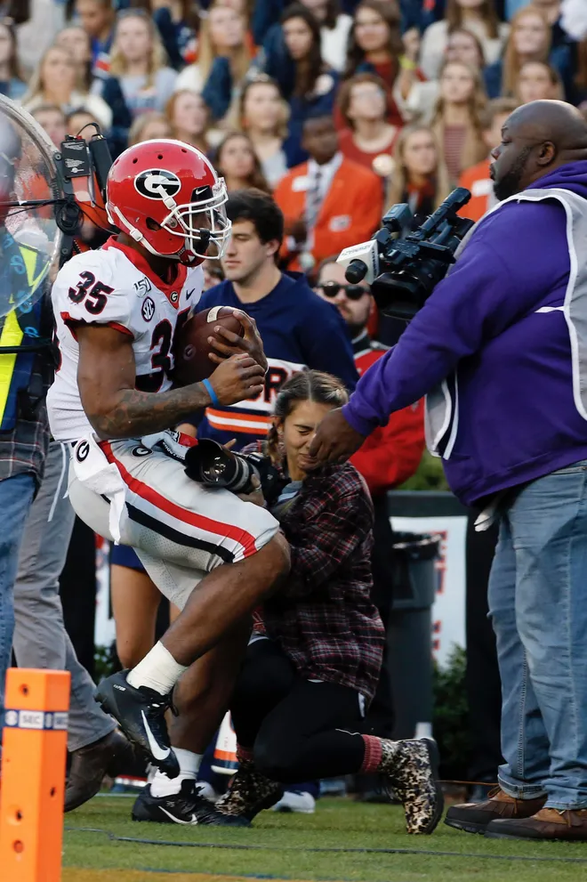
Safety while Working with Photography
Be aware of your surroundings. Don’t be so engrossed in your photo that you end up in harms way.
If you are outdoors, take the usual precautions such as sunscreen, hat, raingear, etc.
Use the buddy system.
Tell someone where you are going.

Slide 9
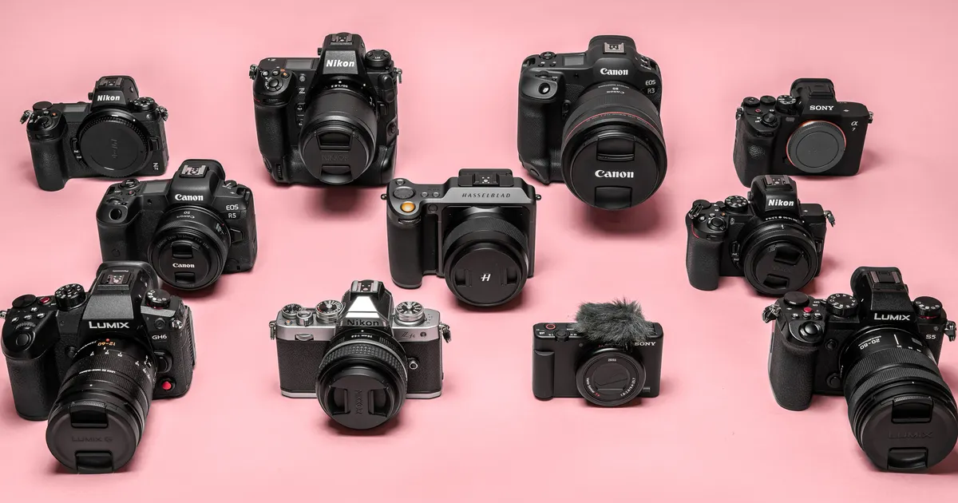
Requirement 3
Explain the basic parts and operation of a camera. Explain how an exposure is made when you take a picture.

Slide 10
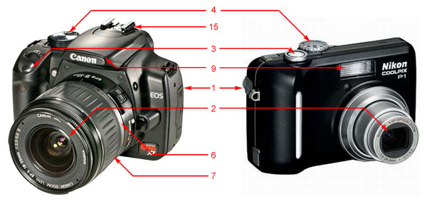
Parts of a Camera
Body - Made of high grade plastic or metal, this holds all the other parts together as well as provide protection to the delicate internal parts of the camera.
Lens - A proper term for this part should be Lens Assembly, this consists of several layers of lenses of varying properties providing zoom, focusing, and distortion correction. These lenses are mechanically interconnected and adjustment is controlled either manually or electronically through the camera's body.

Slide 11
Parts of a Camera
Shutter Release Button - This is the "trigger" of the camera. In most cameras, a half-press activates and locks the auto-focus, and a full press initiates the image capturing process.
Mode Dial - Contains several symbols (slightly different on various camera models), this dial allows you to select a shooting mode, automatic or manual or a choice between one of the pre-defined settings.

Slide 12
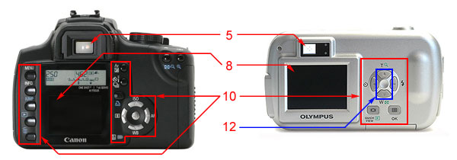
Parts of a Camera
Viewfinder - A small viewing window that shows the image that the camera's imaging sensor sees. This can either be an optical view finder, which shows the actual image in front of the camera through a peep hole or through mirrors, or an electronic view finder which is simply a small LCD display.

Slide 13
Parts of a Camera
Aperture Ring - Found around the old manual lens of SLR camera this is used to select an aperture opening. In modern lenses, the aperture is controlled electronically through the body.
Focusing Ring - This can also be found around the lens of a DSLR camera. This is turned to manually focus the lens.

Slide 14
Parts of a Camera
LCD Display - In some compact cameras this acts as the viewfinder. This is a small screen (usually 1.8" diagonally or bigger) at the back of the camera which can be used for framing or for reviewing the recorded pictures.

Slide 15
Parts of a Camera
Flash - Built-in on the body of most compact and some DSLR cameras this can either be fixed or flip type, it provides an instantaneous burst of bright light to illuminate a poorly lit scene.

Slide 16
Parts of a Camera
Control Buttons - Usually includes a set of directional keys and a few other buttons to activate certain functions and menus, this is used to let users interact with the camera's computer system.

Slide 17
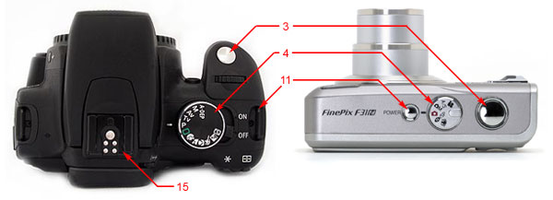
Parts of a Camera
Power Switch - Turns On or Off the camera. This may also contain a Record / Play Mode selector on some cameras.

Slide 18
Parts of a Camera
12. Zoom Control - Usually marked with W and T, which stands for "Wide" and "Tele" respectively, this is used to control the camera's lenses to zoom-in or zoom-out. For DSLR cameras, the zoom is usually controlled by a zoom ring in the lens.

Slide 19
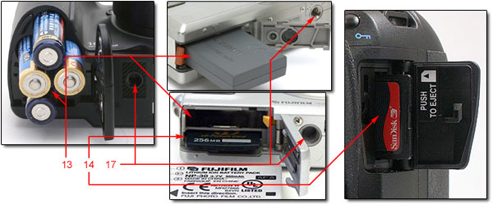
Parts of a Camera
Battery Compartment - Holds the batteries. Depending on the camera model, this varies in size and shape.
Memory Card Slot - This is where expansion memory cards are inserted. The proper position of the card are often indicated. A mechanical catch usually holds the card in place and a spring helps it eject.

Slide 20
Parts of a Camera
Flash Mount (Hot-Shoe) - Standard holder with contact plates for optional Flash accessory.

Slide 21
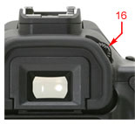
Parts of a Camera
16. Diopter Adjuster - Usually available in mid to high end sub-compact cameras and DSLRs located besides the viewfinder. This varies the focal length of the lens in the viewfinder to make even people wearing eyeglasses to see clearly through it even without the eyeglasses.

Slide 22
Parts of a Camera
Tripod Mount - Here is where your standard Tripod or Monopod is attached for added stability.

Slide 23
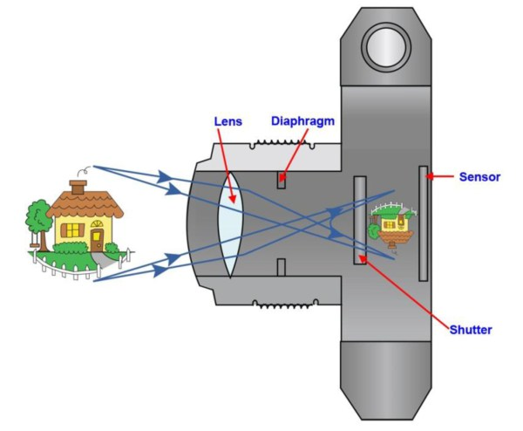
How a Digital Camera Works
You “frame” a scene with help of
a viewfinder or the LCD monitor.
Then, you press the shutter
release to freeze that moment.
Now, a lot of things happen!
The lens is focused to get a sharp image,
Exposure (shutter speed and aperture size) is set
Shutter opens
Image is captured on the sensor as pixels.

Slide 24
How a Digital Camera Works
The shutter now closes.
The pixels are written into a buffer.
The data in the buffer, which is in the form of pixels, is then processed by the CPU to create an image.
The image is then written on the memory card.
You can retrieve the image from the card and use it for sharing, printing or further processing.

Slide 25
Requirement 2
Explain how the following elements and terms can affect the quality of a picture:
  Light—natural light (ambient/existing), low light (such as at night), and artificial light (such as from a flash)
  Exposure—aperture (f-stops), shutter speed, ISO
  Depth of field
  Composition—rule of thirds, leading lines, framing, depth
  Angle of view
  Stop action and blur motion
  Timing

Slide 26
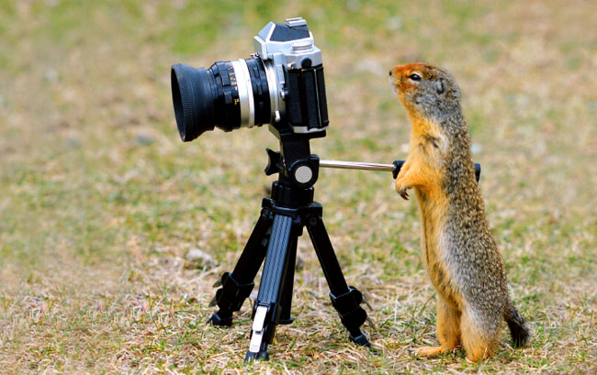
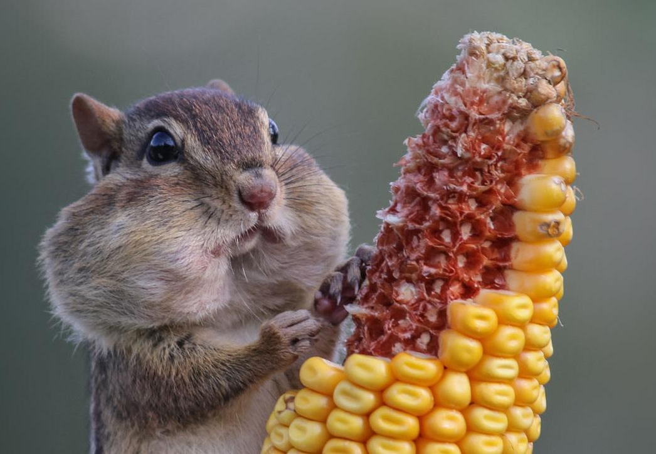
What is a good image?
In Focus
Proper Exposure
Pleasing to the Viewer

Slide 27
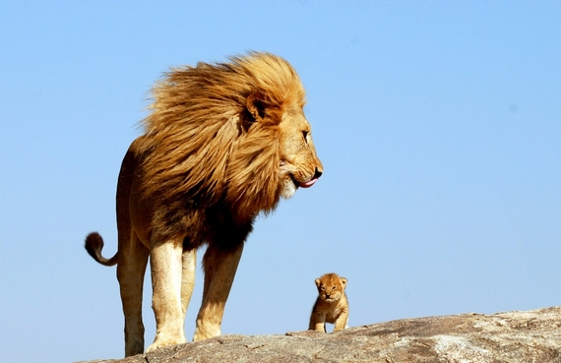
What is a good image?

Slide 28
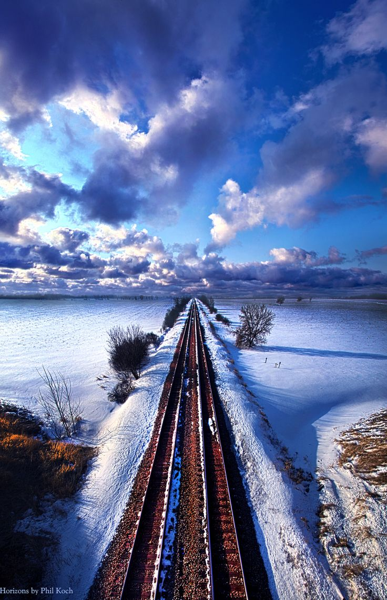
Basics of Digital Photography
Compose: This is the creative or artistic part. Arrange all of the elements of the picture within the frame or viewfinder to produce what should hopefully be a pleasing composition.
Expose: This is the scientific and mechanical bit . Expose the image to light through the lens of the camera and preserve the image for posterity.

Slide 29
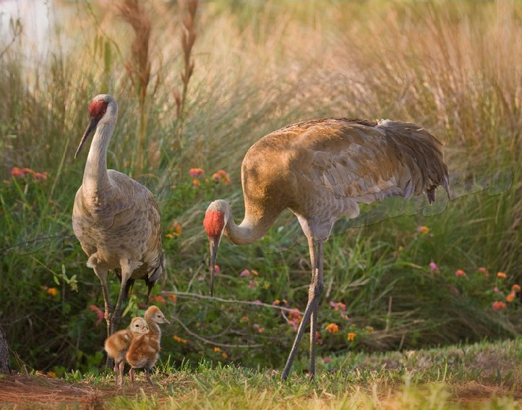
Basics of Digital Photography

Slide 30
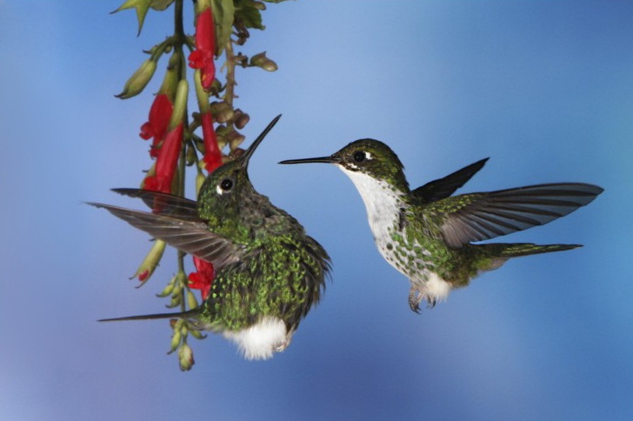
Basics of Digital Photography
It’s all about the Light !

Slide 31
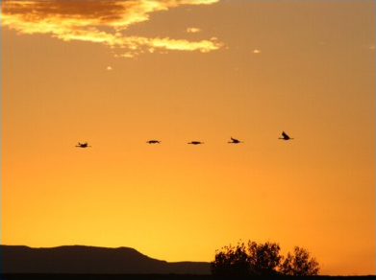
Basics of Digital Photography
Natural light (Sunlight)
Ambient (Light in this room)
Flash
It’s all about the Light !

Slide 32
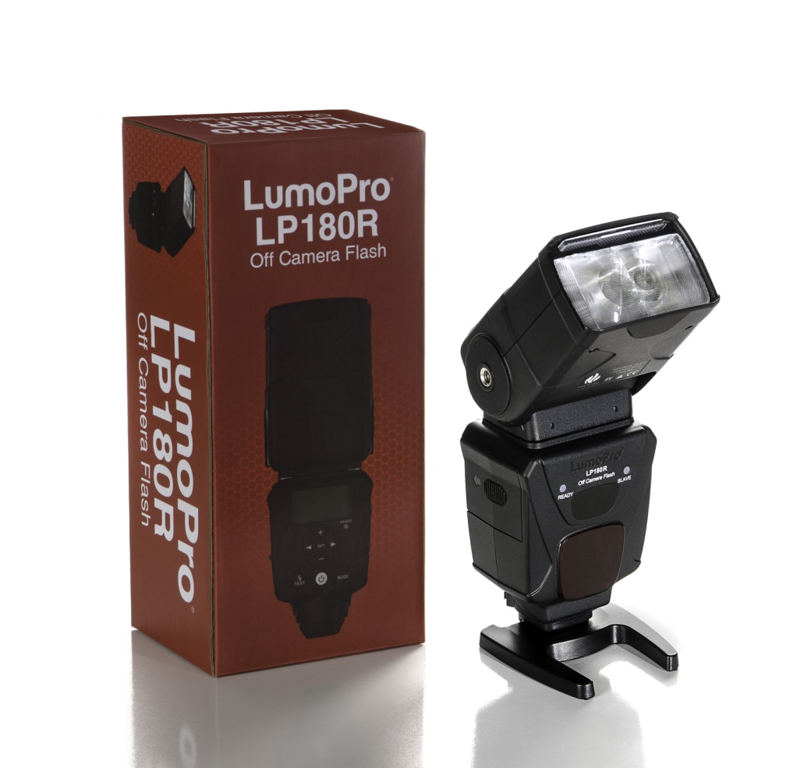
Flash
Off Camera Flash. Why do we use it?
Fill Flash.
Main Light.
Stop Action.

Slide 33
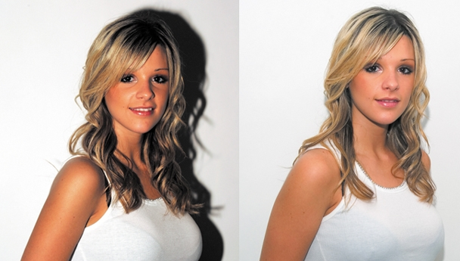
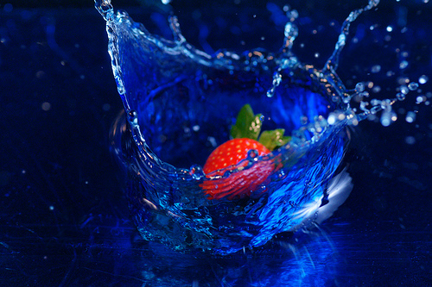
Flash Mode
For dim light or for “filling in” backlit pictures most cameras default to auto flash.
You need to know how to manually turn the flash off or on for special conditions.

Slide 34
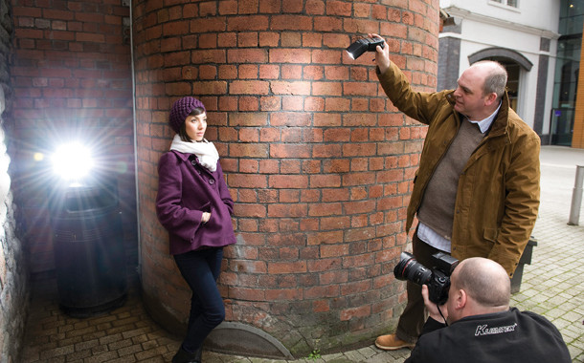
Flash Photography Mistakes
Turn off the flash when it will be useless.
  For example, photographing a person near a reflective background or someone far away under dim light conditions.

Slide 35
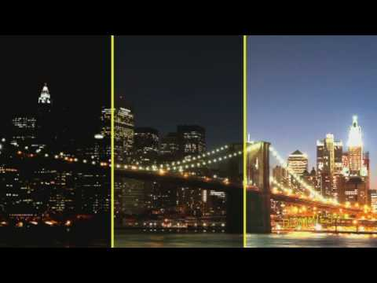
Night Photography
Taking photographs at night without flash requires low shutter speeds.
Your digital cameras night mode.

Slide 36
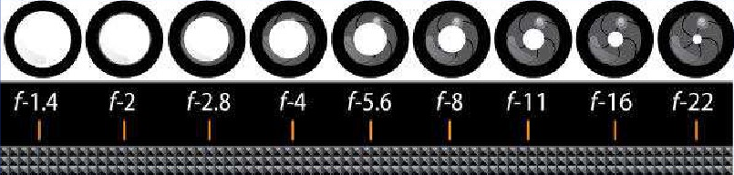
F-stop
Aperture regulates the size of the opening in the lens.
F-stop measures the size of the aperture or opening.
The bigger the F-stop the smaller the opening.
F-2 is an “open” stop - lets in more light.
F-22 is a “closed” stop - lets in less light.

Slide 37
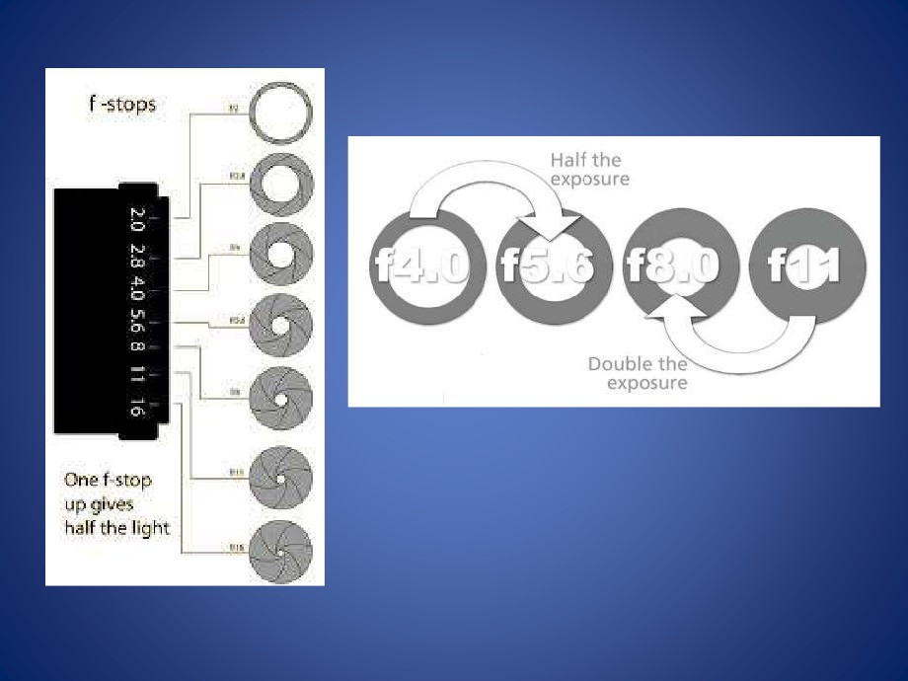
F-stop
Double the F-stop = 1/4 the Light
Half the F-stop = Quadruple the Light

Slide 38
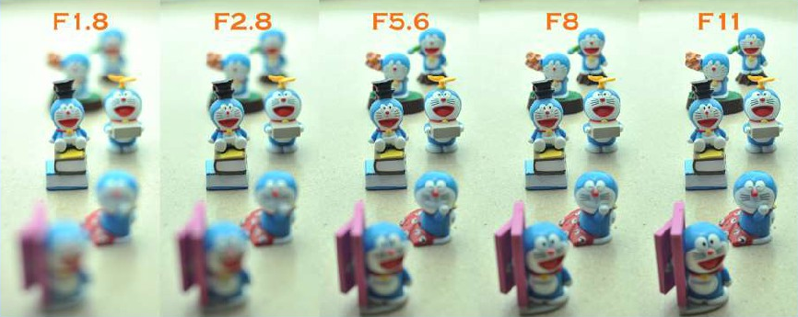
Depth-of-Field and F-stops
Depth-of-Field = Amount in Focus
Smaller F-stop = Less Depth-of-Field (less in focus)
Larger F-stop = More Depth-of-Field (more in focus)

Slide 39
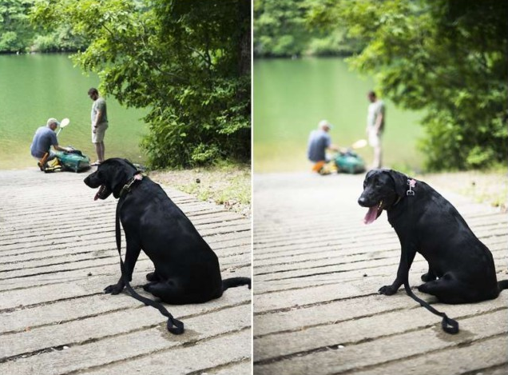
Depth-of-Field
How does Depth-of-Field change the photograph?

Slide 40
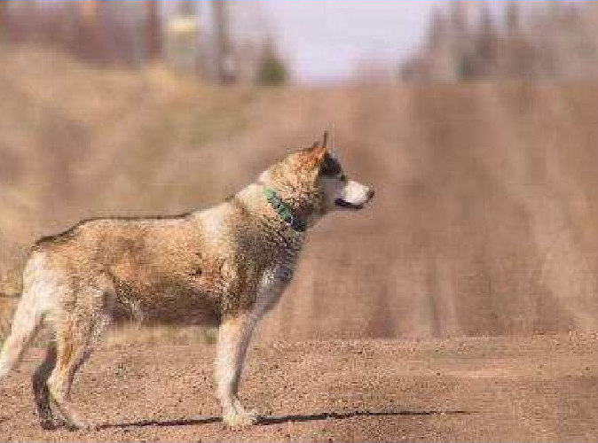
Depth-of-Field
Is this closer to f/2 or f/22?

Slide 41
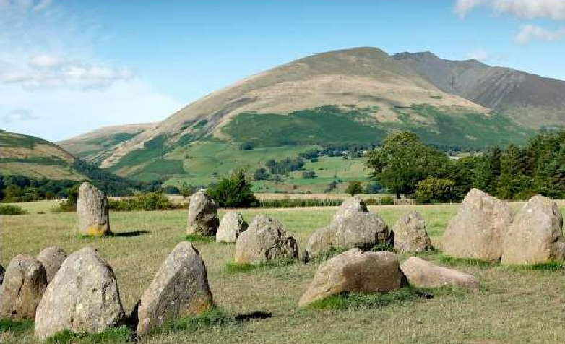
Depth-of-Field
Is this closer to f/2 or f/22?

Slide 42
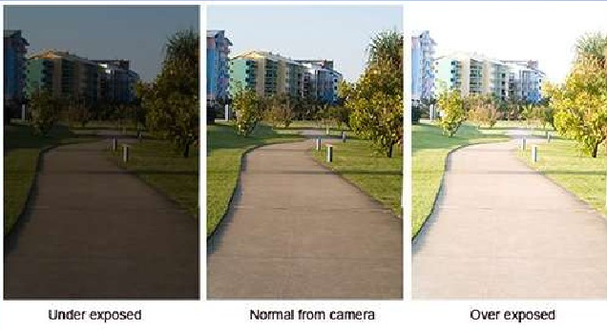
Exposure
Exposure is the amount of light used to take a picture.
Over-Exposure = Picture is to light
Under-Exposure = Picture is to dark

Slide 43
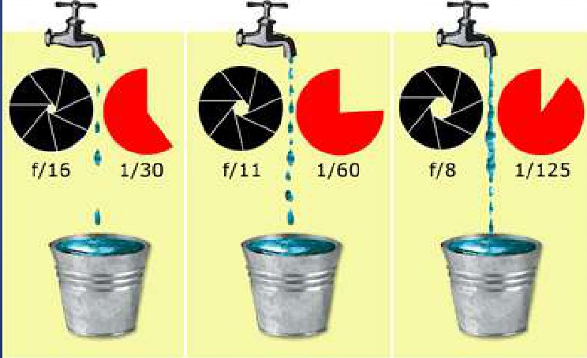
Exposure
Exposure is controlled by the aperture and the shutter.

Slide 44
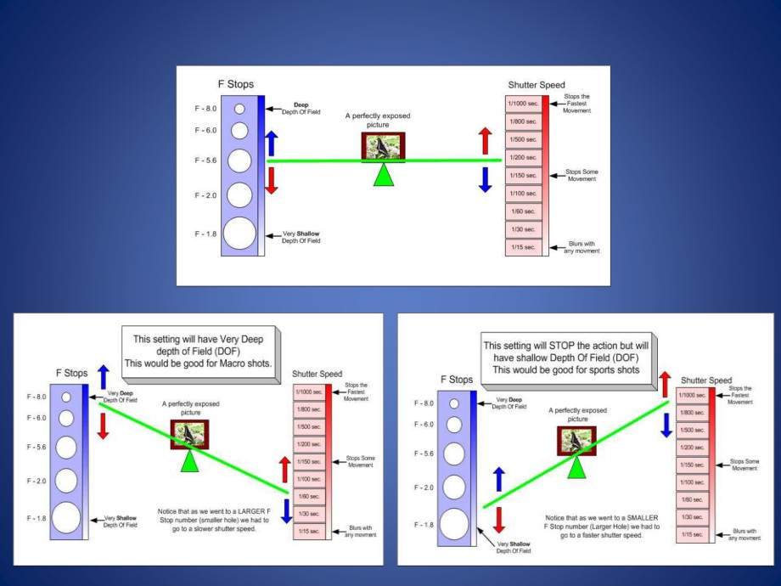

Slide 47
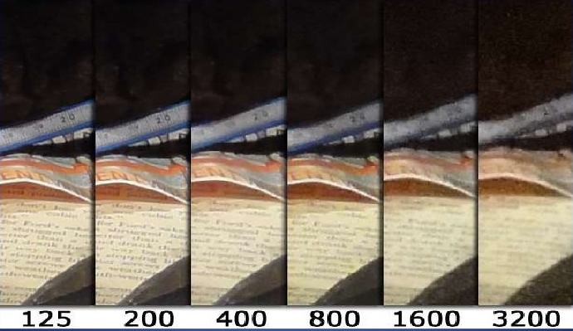
ISO
ISO adjusts the cameras sensitivity to light.
The higher the ISO, the less light is needed.
The higher the ISO, the higher the image noise.

Slide 48
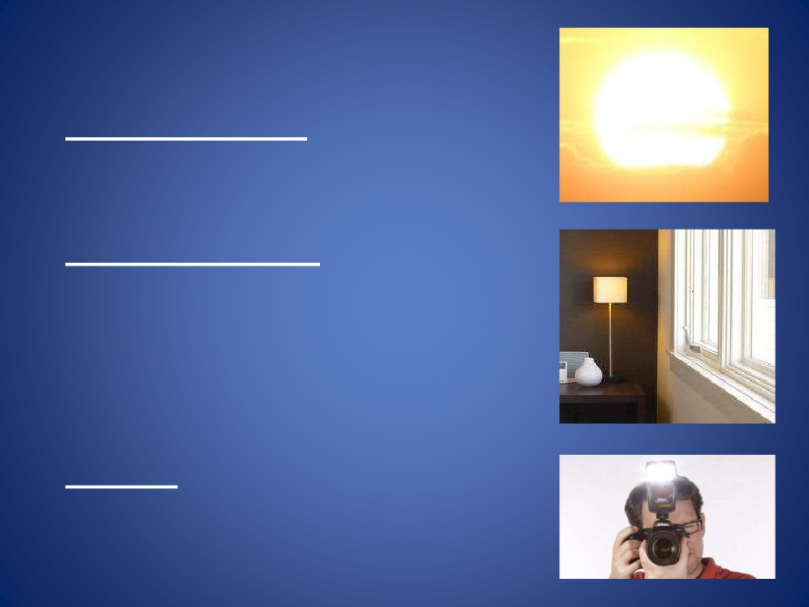
Light
•
“Natural” Light - light from the Sun (inside or outside).
“Ambient” Light - natural or
artificial lighting that exists at the scene without a flash or other photographic lights.
“Flash” - a brief high intensity
artificial light used to illuminate photographs at close range.

Slide 49
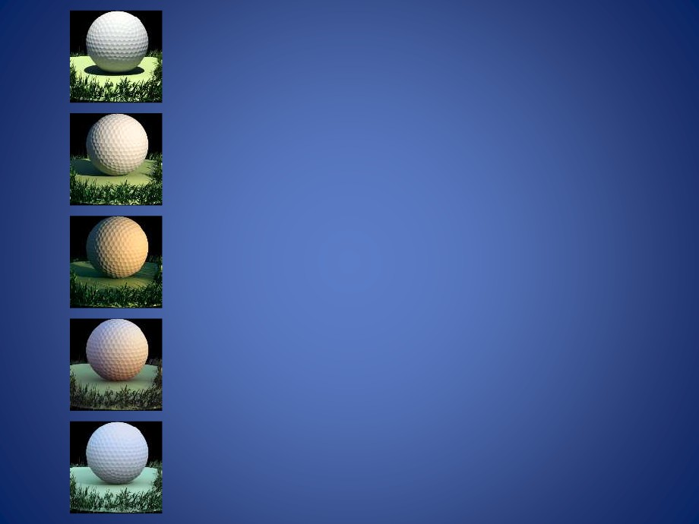
Types of Natural Light
CLEAR MIDDAY SUNSHINE - Primarily comprised of direct, downward sunlight. The hardest and most neutrally-colored lighting of any time of day, and typically is the least desirable natural light.
MID-MORNING & EVENING - Mid-morning and Evening light becomes slightly warmer, and begins to cast noticeable shadows making subjects often appear much more three dimensional.
SUNRISE/SUNSET (GOLDEN HOUR) - The hour just after sunrise or just before sunset provides very desirable light characterized by horizontal light that casts long shadows and gives subjects a warm glow and depth.
TWILIGHT, DAWN & DUSK - The half hour before sunrise or after sunset while the sky is still light but without direct sunlight. This light produces soft, multicolored lighting, from warm and reddish to cool blue or purple, that gives a calm, peaceful mood to subjects.
SHADE & OVERCAST SUNLIGHT - Typically has a cool, soft appearance, since the source of such light is spread across the entire sky, and doesn't include any direct sunlight.

Slide 50
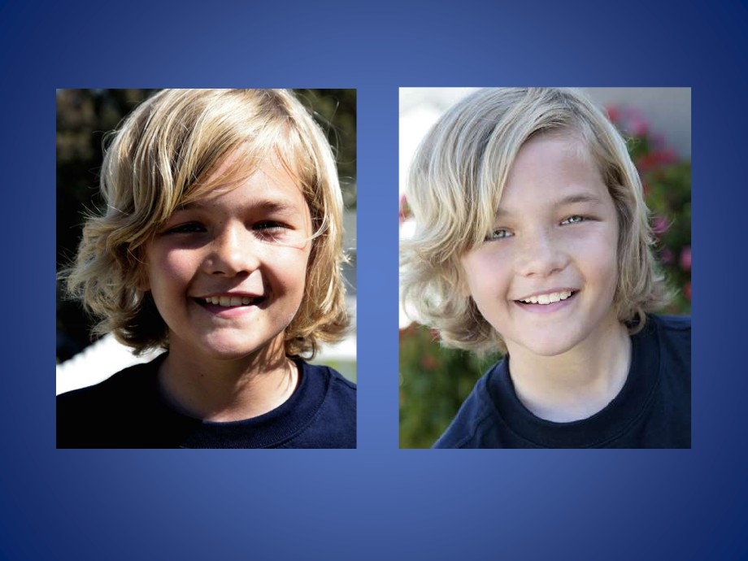
Direct Sun
Shade

Slide 51
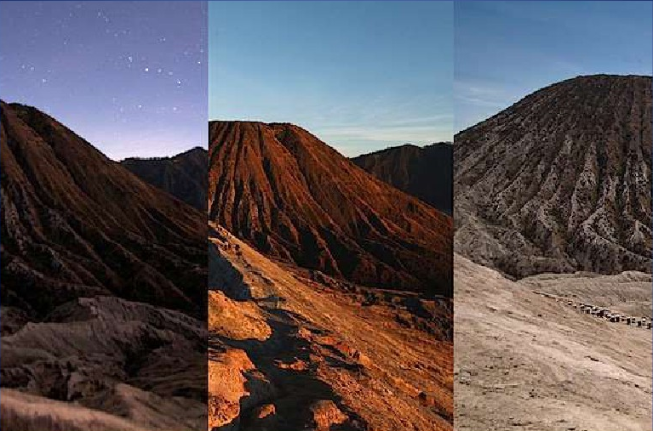
Twilight
Sunrise
Noon

Slide 52
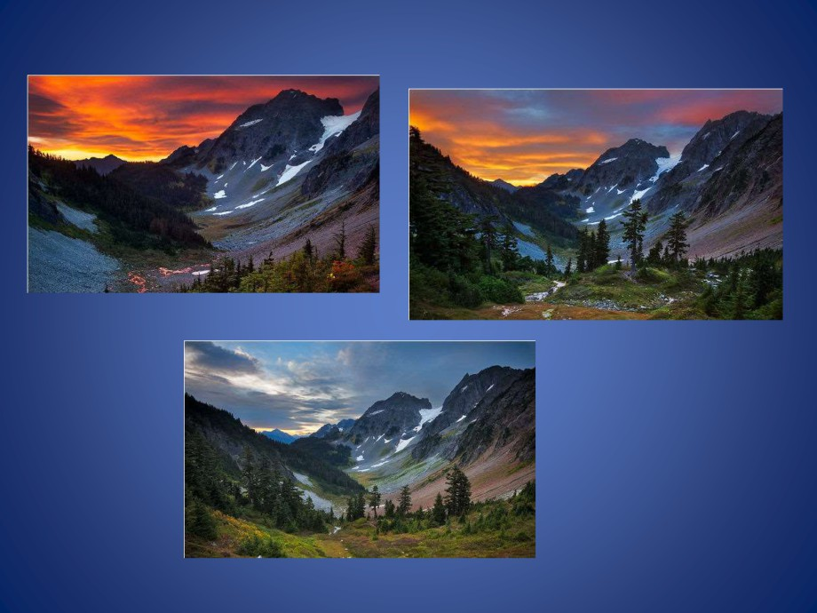
Dawn
Sunrise
Morning

Slide 53
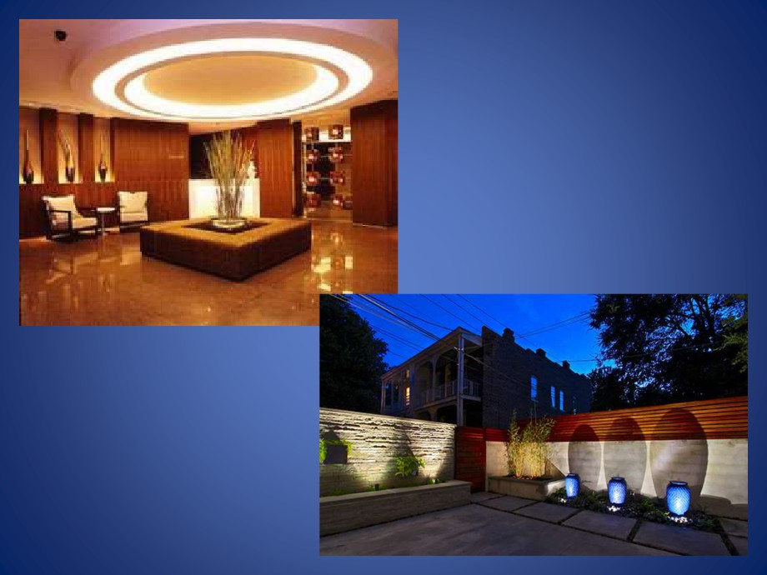
Ambient Light

Slide 54
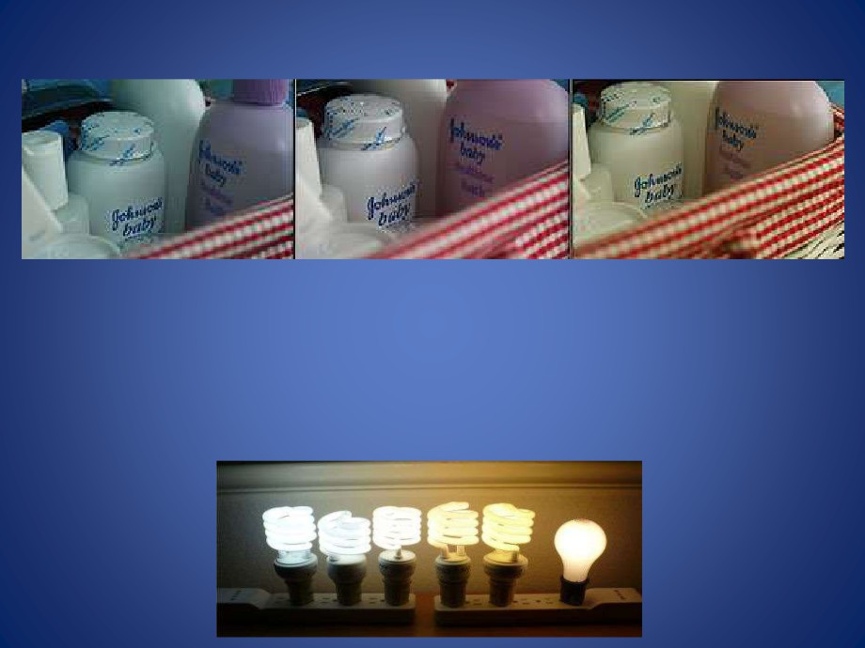
Florescent Lights can add a bluish-green cast to photos.
Incandescent Lights add a yellowish tinge to photos.
Most digital cameras have a White-Balance which can compensate for unflattering types of light.

Slide 55
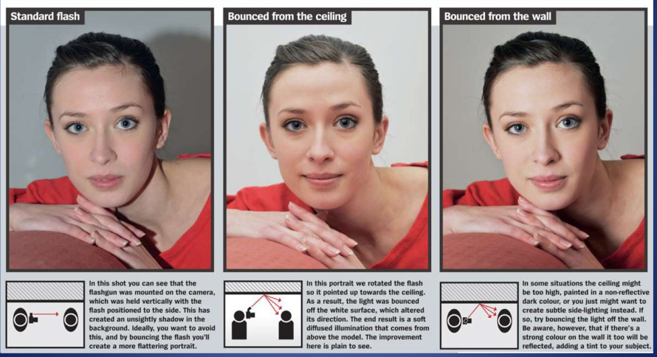

Slide 56
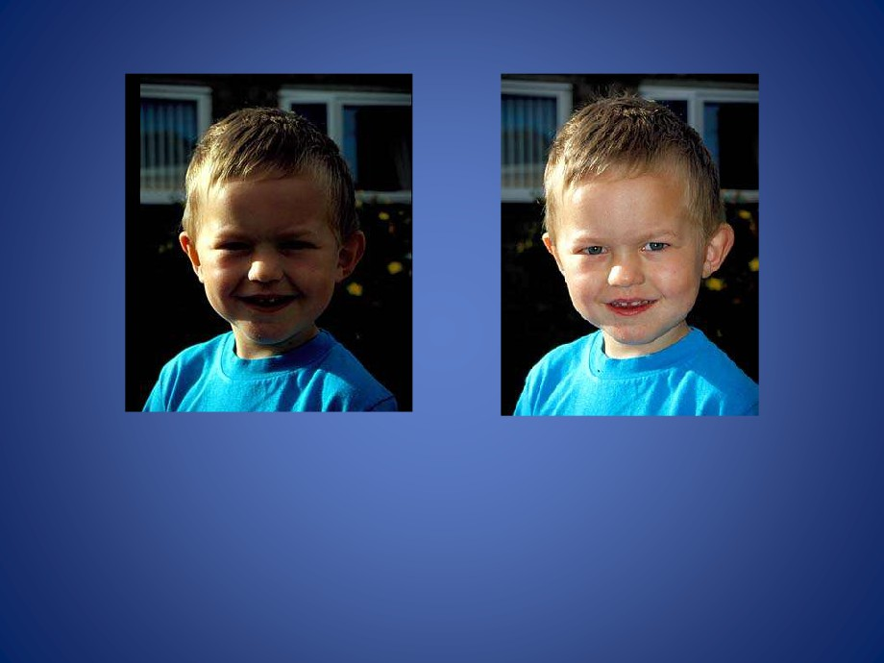
Using Flash
Direct sunlight can create harsh shadows, especially
if you do not want your subject squinting in the sun.
Using your Flash to Fill in the shadows can brighten an image.

Slide 57
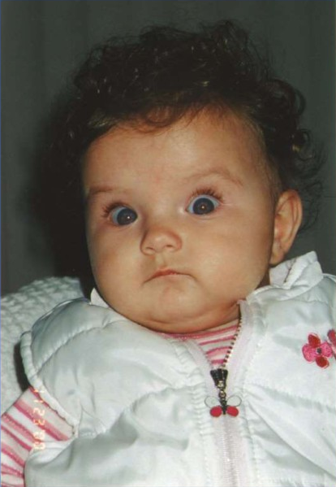
Ambient or Flash Lighting?

Slide 58
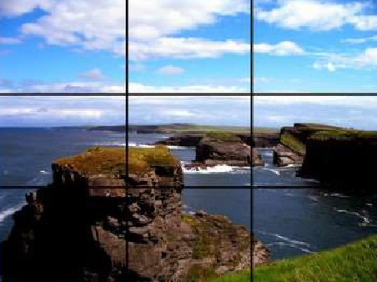
Rule of Thirds
Keep the subject of interest out of the center of the picture.
The Rule of Thirds is applied by aligning the subject
with the intersecting points of imaginary guide lines dividing the picture into nine (9) equal boxes.
One of the most important rules of composition.

Slide 59
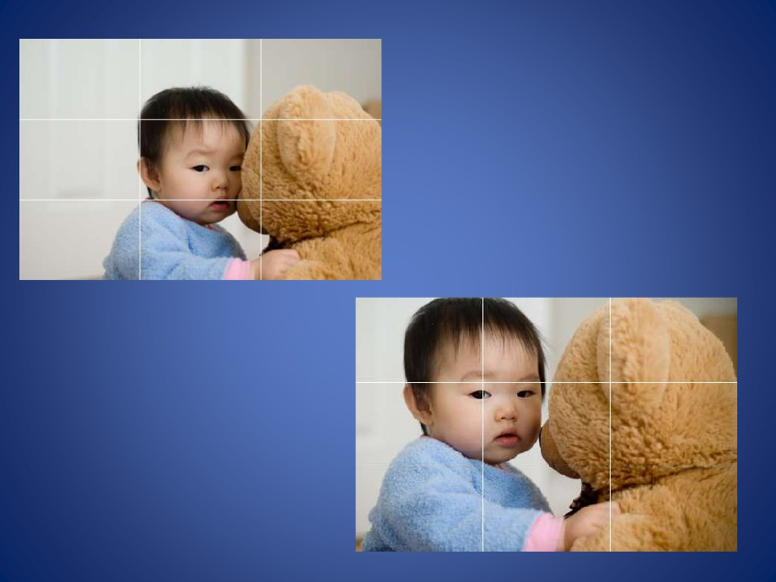
“Rule of Thirds”
From Good to GREAT!

Slide 60
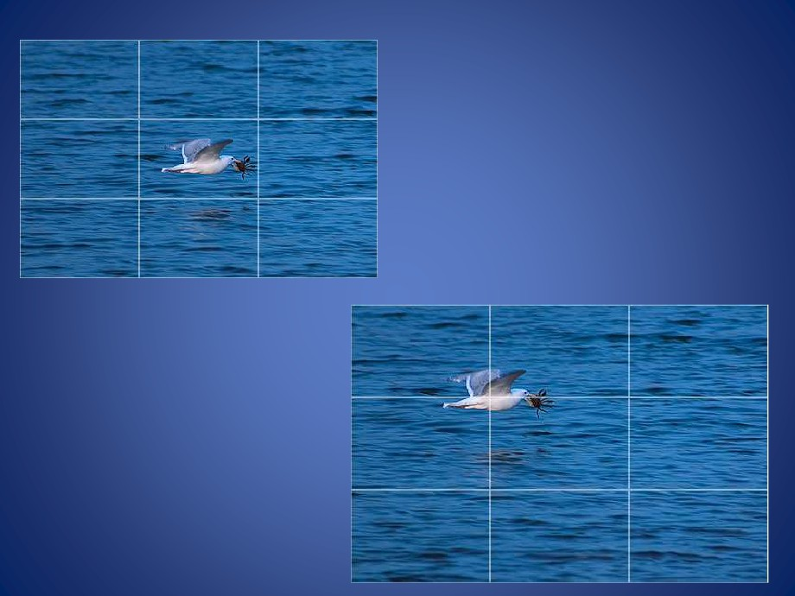
“Rule of Thirds”
Now the seagull has more room to fly, giving a greater sense
of action and depth.

Slide 61

Rule of Thirds
Rule of Thirds may be broken when other rules of composition are used to focus on the subject.
Learn to use the Rule of Thirds effectively before trying to break it, then you will be doing so to get a better composition and not just for the sake of it.
Once you’ve mastered the Rule of Thirds, experiment with purposely breaking it to see what you discover.

Slide 62
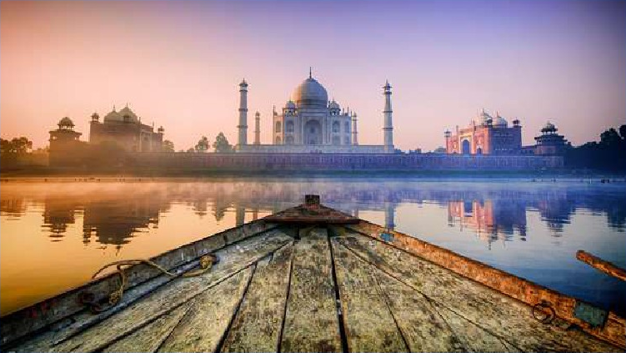
Leading Lines
Leading Lines are used to draw a viewers
attention to a specific part of a picture.

Slide 63
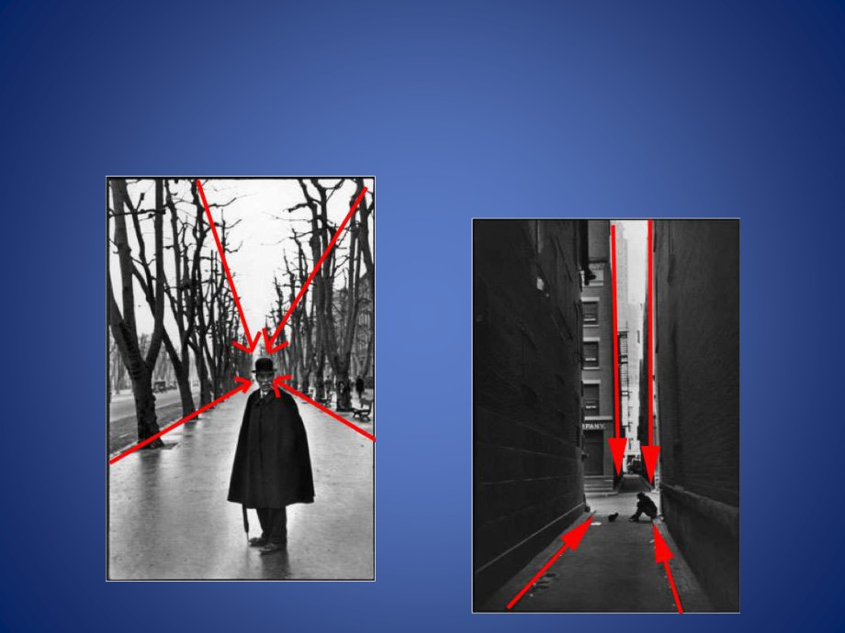
Leading Lines
Leading Lines can be almost anything: a road, path, sidewalk, fence, river, hedge, tree line or shadow.

Slide 64
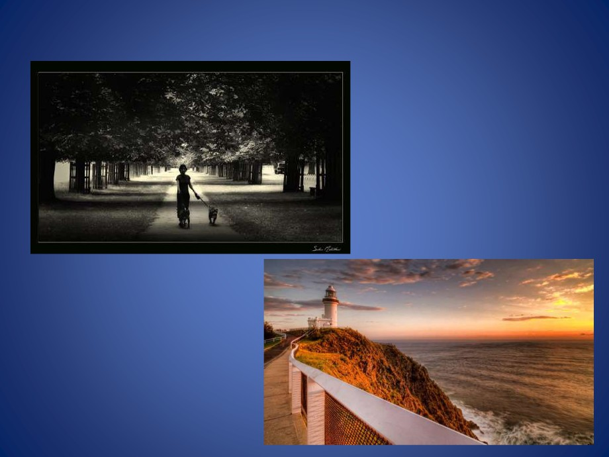
Leading Lines
Leading Lines may draw a viewers attention to the subject
. . . or to a vanishing
point in the background.

Slide 65
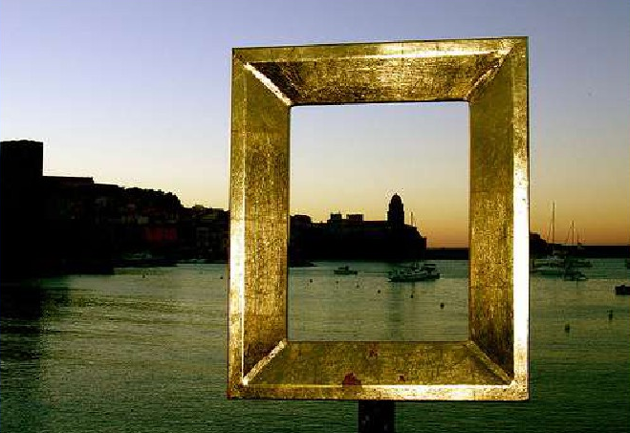
Framing
Using other objects in your photograph to frame the main subject.

Slide 66
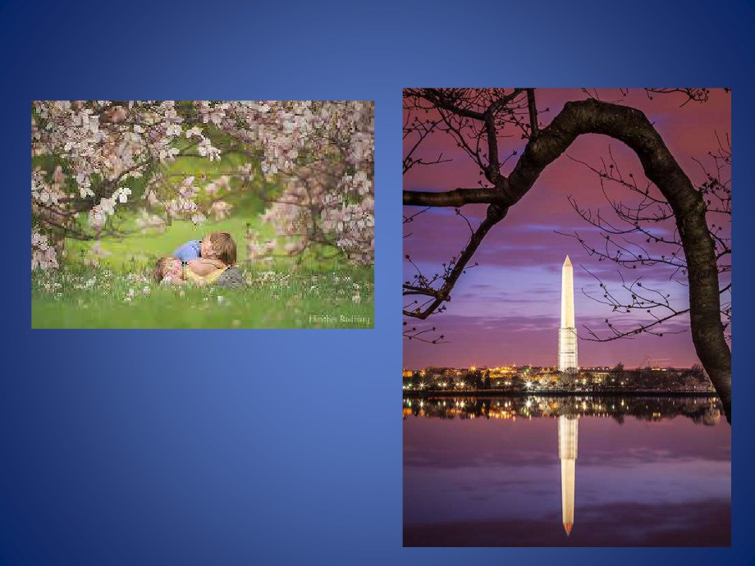
Framing
Use trees or objects to provide a natural “frame.”

Slide 67
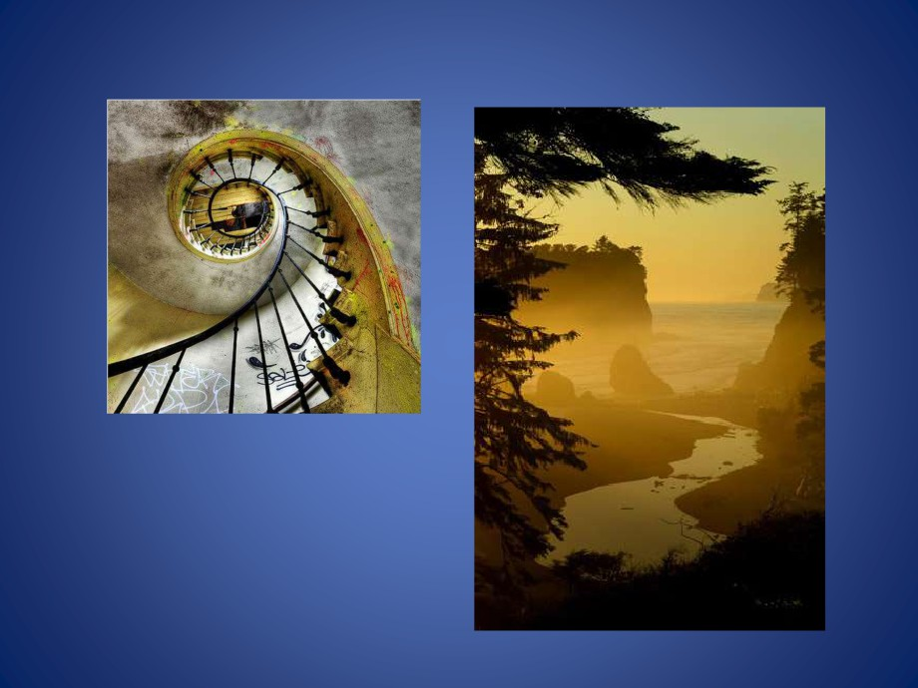
Framing
Framing brings more
depth to the picture and a better focus on what the main subject is.

Slide 68

Depth
A good foreground can
really give Depth to an
image and make it POP.
To take it a step further, make sure there is a foreground, mid-ground and background to your image, which will dramatically allow you to take control of the sense of Depth in your image.

Slide 69
Depth
Depth can also be achieved by using all of the other composition rules: Rule of Thirds, Leading Lines, and Framing.

Slide 70

Depth
A change in viewpoint can strikingly alter the Depth of a photo.
Angling the camera up for a scenic shot is a fun way to experiment with converging lines to add Depth.
Try getting low to the ground to include some interesting foreground
to add Depth.

Slide 71

Depth
The right lighting can add a three-dimensional feel to your photos.
For scenic shots, the late afternoon sun provides both a warm glow and deepening shadows which will make your photos stand out.

Slide 72

Depth
Wide-angle lenses exaggerates Depth by making close objects appear larger while creating converging lines that make distant objects appear smaller than normal.
• Telephoto lenses cause images to appear more compressed, with less background, reducing the sense of Depth.

Slide 73

Angle of View
Angle of View is the maximum view a camera is capable of “seeing” through a lens, expressed in degrees.
Angle of View depends on a camera lens focal length stated in millimeters.
Smaller mm = wider Angle of View (wide-angle lens)
Larger mm = narrower Angle of View (telephoto lens)

Slide 74

Angle of View
With a wide Angle of View (wide-angle lens), MORE of the background will fit in the image.
With a narrow Angle of View (telephoto lens), LESS of the background will fit in the image.

Slide 75

Shutter Speeds
The camera shutter controls how long light enters the camera.
A fast shutter speed is 1/1000 of a second.
A slow shutter speed is 1/2 of a second.

Slide 76

Shutter Speed
A fast Shutter Speed can stop action.
A slow Shutter Speed can blur action.

Slide 77

For Sports, use a “fast” shutter speed, like 1/500 or 1/1000 to stop action.
Hummingbird wings requires a shutter speed in excess of 1/10,000 second to stop action, which is not possible for most cameras.
Using an external flash can stop Hummingbird wings because flash durations are typically 1/35,000 second.

Slide 78

Is this closer to 1/2 sec. or 1/1000 sec.?

Slide 79

Is this closer to 1/2 sec. or 1/1000 sec.?

Slide 80

Is this closer to 1/2 sec. or 1/1000 sec.?

Slide 81

Is this closer to 1/2 sec. or 1/1000 sec.?

Slide 82


Practice with Your Camera
The best way to take good pictures is to take a lot of them and to experiment with your camera.
Understand your camera settings
Take pictures and do tests: Take the same picture several times while changing the settings for each shot. Then compare the result. What settings work best under what conditions? What are the characteristics of your camera?
Digital pictures are FREE
until you print them!

Slide 83
Requirement 4
Do TWO of the following, then share your work with your counselor.
  Photograph one subject from two different angles or perspectives.
  Photograph one subject from two different light sources—artificial and natural.
  Photograph one subject with two different depth of fields.
  Photograph one subject with two different compositional techniques.

Slide 84

Requirement 4 Photo Examples
One subject from different angles or perspectives.

Slide 85

Requirement 4 Photo Examples

Slide 86

Requirement 4 Photo Examples
Photographs using different depths of field

Slide 87



Requirement 4 Photo Examples
Rule of Thirds
Leading Lines
Framing

Slide 88
Requirement 5
Photograph THREE of the following, then share your work your counselor.
  Close-up of a person
  Two to three people interacting
  Action shot
  Animal shot
  Nature shot
  Picture of a person—candid, posed, or camera aware

Slide 89


Requirement 5 Photo Examples
Close up photography refers to a tightly cropped shot that shows a subject (or object) up close and with significantly more detail than the human eye usually perceives.
People interacting photography

Slide 90


Requirement 5 Photo Examples
An action shot is a still photograph that shows someone or something in motion.
Animal photography

Slide 91


Requirement 5 Photo Examples
Nature photography is a wide range of photography taken outdoors and devoted to displaying natural elements such as landscapes, wildlife, plants, and close-ups .
A candid photograph is a photograph captured without creating a posed appearance.

Slide 92


Requirement 5 Photo Examples
Posed photos are constructed by the photographer and are often controlled. Tilt your head this way, move your leg this way; it's a deliberate act to capture the subject in a specific manner.
A camera aware photo is a picture where the subject becomes aware the photo is being taken.

Slide 93
Requirement 6
Describe how software allows you to enhance your photograph after it is taken. Select a photo you have taken, then do ONE of the following, and share what you have done with your counselor.
  Crop your photograph.
  Adjust the exposure or make a color correction.
  Show another way you could improve your picture for impact.

Slide 94
Photo Editing Basics
The basic photo editing techniques should be available in even simple editing programs, and each can enhance your images to make them more powerful and shareworthy.
Understand how number of pixels, image size, and file types can impact editing.

Slide 95

Pixels

A pixel is a contraction of the term Picture Element.
Digital images are made up of small squares, just like a tile mosaic on your kitchen or bathroom wall.
Though a digital photograph looks smooth and continuous just like a regular photograph, it's actually composed of millions of tiny squares as shown below.
On the left the full image, on the right the area in the red square magnified to show individual pixels

Slide 96

Megapixels
A megapixel is equal to 1 millions pixels.
How many megapixels a camera shoots indicates the maximum size of a digital picture.
Generally, more pixels are better (and cost more), but it is not only factor that should be considered when choosing a camera.

Slide 97

Image Size
Refers to the dimensions of the image, measured in pixels.
Pictures taken at smaller sizes require less memory and are suitable for distribution by email or on the web.
Conversely, the larger the image, the larger the size at which it can be printed or displayed without loosing quality (becoming “grainy”).

Slide 98


Image Size
11” x 14”
5MP
8½” x 6½”
3MP
7” x 5”
2MP
5” x 4”
1280 x 960
640 x 480
4” x 3”
Email and Web
1MP
.5MP

Slide 99
File Types
JPEG (JPG): The most common format. This is a loss compression format that can be saved at various qualities.
TIFF: A “loss-less” compression format of a higher quality that is better for very high quality prints but has larger file size.
RAW: Actual image from the camera sensor
  Consider shooting in RAW image format for the greatest editing control.
  You should also be certain your editing program can work with RAW images.

Slide 100
Things to Think About Before You Begin Editing
Photo editing programs:
  Options include advanced and expensive pro programs, free open-source online options, and often your camera comes with basic editing software as well.
  There are several free phone apps available to allow you to edit pictures on your smartphone.
Understand the difference between “nondestructive” and “destructive” editing:
  Some editing software automatically preserves your originals—nondestructive editing.
  Others save edited images over originals—destructive editing.
  Editing involves trial and error, and you need to be able to return to an original file if you make a mistake.
  So make sure you know if your editing program makes copies of your originals.
  If it doesn’t, then make a copy of all images you plan to edit before you begin.

Slide 101

Free Photo Editors for Beginners
Click on one of the links below to check out free photo editors.
Gimp
Paint.NET
PhotoScape
Photo Pos Pro

Slide 102

Photo Editing Basics
You don’t have to do all of the basic editing steps on every image, but the steps you choose to do should be done in the order listed on the following slides.

Slide 103


Crop and Clean Up Your Images
Straighten images: It’s always better to pay attention to be sure your horizon is horizontal when you shoot, but straightening is also an easy first editing step.
Crop images: It’s best to crop to improve minor compositional details, like distracting elements at the edge of the frame or repositioning your subject slightly.

Slide 104

Crop and Clean Up Your Images
Spot-clean images: The outdoors is a dusty place and nature’s gritty elements have a way of finding their way onto your camera lens, and then onto your photos. (Using a lens brush regularly in the field cuts down on this.)
Most editing programs have a spot-removing tool. The name varies: “clone stamping” and “spot healing” are two variations. Work your way methodically around your photo until you have a spot-free image.

Slide 105


Adjust the White Balance
White balance relates to color levels, not exposure levels. If your image has an overall color tone that you find displeasing or unnatural, you can adjust white balance to fix it. Note that JPG files, because they capture far less digital data than RAW files, offer a minimal amount of white balance adjustment during editing.
Most editing programs let you pick from preset modes like “flash,” “daylight” or “cloudy” to better calibrate the image for the lighting conditions when it was shot. In addition, many have both a “temperature” and a “tint” slider that you can fiddle with to fine-tune the overall lighting cast on an image.

Slide 106


Adjust Exposure and Contrast
Adjusting exposure: This is the process of making the photo exactly as bright or dark as you want. Note that “noise” (a mottled look) can sometimes be introduced when you crank up the brightness. That’s why it’s always better to get the correct exposure (one that’s sufficiently bright) when you first take the photo.
Adjusting contrast: Contrast is the range of dark to light tones. When it’s extra high, you see a stark image, where all tones, regardless of color, are either very dark or very light. When it’s extra low, you see a flat image where no elements in the frame stand out. Typically, you want a middle contrast that avoids either of those extremes. But if you prefer either of those effects, you can adjust the contrast to achieve that.

Slide 107

Adjust Color Vibrancy and Saturation
Once white balance is adjusted, you can further refine colors in your photos with the saturation and vibrancy controls. The distinction between the two is subtle: Increasing vibrancy increases color intensity in neutral color tones and maintains color intensity in the brighter colors. Increasing saturation makes all colors throughout the frame more intense. When bright colors pop, it can give the photo a more dramatic look.

Slide 108

Adjust Sharpness
Sharpening an image gives it a crisper, cleaner look. Many programs offer multiple sharpening tools. Begin by adjusting the overall amount of sharpness (on a scale from 0 to 100). Start at 50 percent, then adjust the level up or down to get the sharpness you prefer.
Experiment with your editing program's additional sharpening features to see the effect each produces. One you might try is a “clarity” or “structure” tool. It makes the edges of objects in the photo stand out more. You need to look closely at individual areas of the frame in order to evaluate the effect of each sharpness adjustment.
Note that sharpening an image can’t turn an out-of-focus shot into an in-focus shot. No editing tool can do that. In addition, if you sharpen an image too much you can create an unnatural halo effect around objects in the frame.

Slide 109

Photo Editing
Create a Photo that is
. . . Out-of-this-WORLD!

Slide 110
Requirement 7
Using images other than those created for requirements 4, 5 or 6, produce a visual story to document an event to photograph OR choose a topic that interests you to photograph. Do the following:
  Plan the images you need to photograph for your photo story.
  Share your plan with your counselor, and get your counselor's input and approval before you proceed.
  Select eight to 12 images that best tell your story. Arrange your images in order and mount the prints on a poster board, OR create an electronic presentation. Share your visual story with your counselor.

Slide 111
What Is a Photo Story?
A photo story tells a story visually.
  Just like a story you read, the photo story offers a complete rendering of a subject or situation using a series of carefully crafted and curated images.
  Photo stories have a theme and each image backs up that overarching theme which is defined in the photo story’s title and is sometimes supported with text.
  Photo stories are designed to move their audience, to inspire a certain action, awareness, or emotion.
  Photo stories are not just a collection of cool photos.

Slide 112

How to Choose a Theme
Photo stories exist in everyday life and in current events.
A good place to begin developing a photo story is by choosing a general theme.
  Topics that interest you.
  Personal experiences.
  Problem/solution.
  Day in the life.
  How to…

Slide 113
Choose a Type of Photo Story
Narrative story
  Narrative deals with problems and solutions.
  Some sort of narrative thread must push the story from beginning to middle to end, just like what you see in a good movie.
  A good story also requires action, which in this case must be visual.
  Adventure stories are one good example of photographic narrative storytelling.
  Essay
    The essay type of photo story implies opinion, they argue.
    Essays make a point.
    They are the opposite of facts-only news.
    A photo story essay makes a case for something like advocating for the preservation of a forest.
  Documentary
    Their purpose is to inform without adding judgment.
    Documentaries present the facts and let viewers decide.
    Historical places, current events, and unique lifestyles always make for good documentary photo stories.

Slide 114
How To Make Photo Stories
Give Your Project a Title.
  Consider the title like a magazine headline that explains in a few words what the whole story is about.
Plan Your Photo Stories
  Create a basic outline or a Storyboard – By laying out your ideas shot by shot you can prepare your photo story before you head out to take your photos.
Get the Right Images
  If you have a shot list or storyboard, you’ll be well-prepared to take on your photo essay.
  Make sure you give yourself enough time and take plenty of photos so you have a lot from which to choose.
Assemble Your Story
  Once you organize your photos on your computer, you need to choose the pictures that tell the most compelling photo story or stories.

Slide 115
How To Make Photo Stories
Variety
  A good photo essay is composed of a variety of views, angles, and focal lengths.
Visual Consistency
  The idea of a photo essay is to create a whole, not a bunch of random parts.
  The images must interact with each other and the theme.
Captions
  Text can augment the impact of a photo essay.
  Captions can be as short as a complete sentence, as long as a paragraph, or longer.
  Some photo stories, however, function just fine without words.

Slide 116

Photo Story Example

Slide 117

Requirement 8
Identify three career opportunities in photography. Pick one and explain to your counselor how to prepare for such a career. Discuss what education and training are required, and why this profession might interest you.

Slide 118


Career Opportunities in Photography
Photojournalist (newspaper/magazine/web)
Advertising/Corporate photographer
Architectural/Industrial photographer
Outdoor or wildlife photographer
Sports photographer
“Location” photographer
Fashion photographer
Forensic photographer

Slide 119

Education and Training
Four (4) years of college (B.A. degree) and/or 2+ years apprenticeship as photographer’s assistant
Lots of hard work!

Slide 120

Photography
Can provide a lifetime of fulfillment as a hobby
Can complement other hobbies
Difference between “professional” and “amateur” is not always skill level.

